Slide 1
Hadoop: what is it?

Slide 2
Hadoop manages:
processor time
memory
disk space
network bandwidth
Does not have a security model
Can handle HW failure

Slide 3
Issues:
race conditions
synchronization
deadlock
i.e., same issues as distributed OS & distributed filesystem

Slide 4
Hadoop vs other existing approaches
Grid computing: (What is this?)
e.g. Condor
MPI model is more complicated
does not automatically distribute data
requires separate managed SAN

Slide 5
Hadoop:
simplified programming model
data distributed as it is loaded
HDFS splits large data files across machines
HDFS replicates data
failure causes additional replication

Slide 6
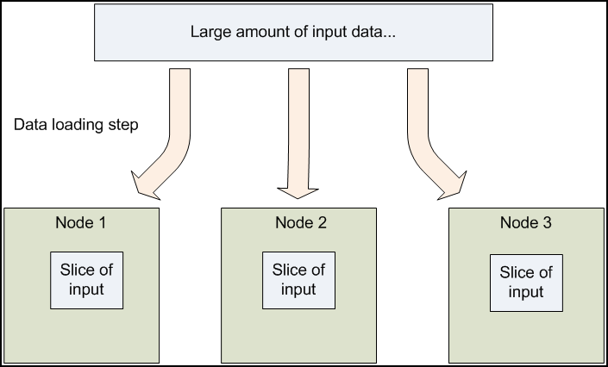
Distribute data at load time

Slide 7
MapReduce
Core idea: records are processed in isolation
Benefit: reduced communication
Jargon:
mapper – task that processes records
Reducer – task that aggregates results from mappers

Slide 8
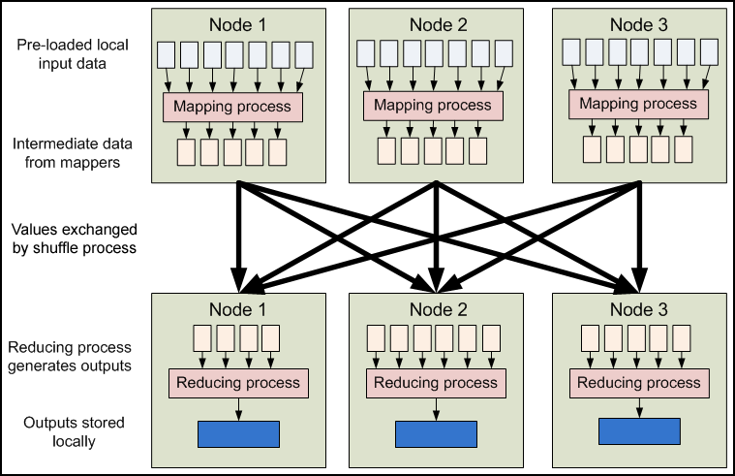
MapReduce
TIME

Slide 9
How is the previous picture different from normal grid/cluster computing?
Grid/cluster:
Programmer manages communication via MPI
vs
Hadoop:
communication is implicit
Hadoop manages data transfer and cluster topology issues

Slide 10
Scalability
Hadoop overhead
MPI does better for small numbers of nodes
Hadoop – flat scalabity ➔ pays off with large data
Little extra work to go from few to many nodes
MPI – requires explicit refactoring from small to larger number of nodes

Slide 11
Hadoop Distributed File System
NFS: the Network File System
Saw this in OS class
Supports file system exporting
Supports mounting of remote file system

Slide 12
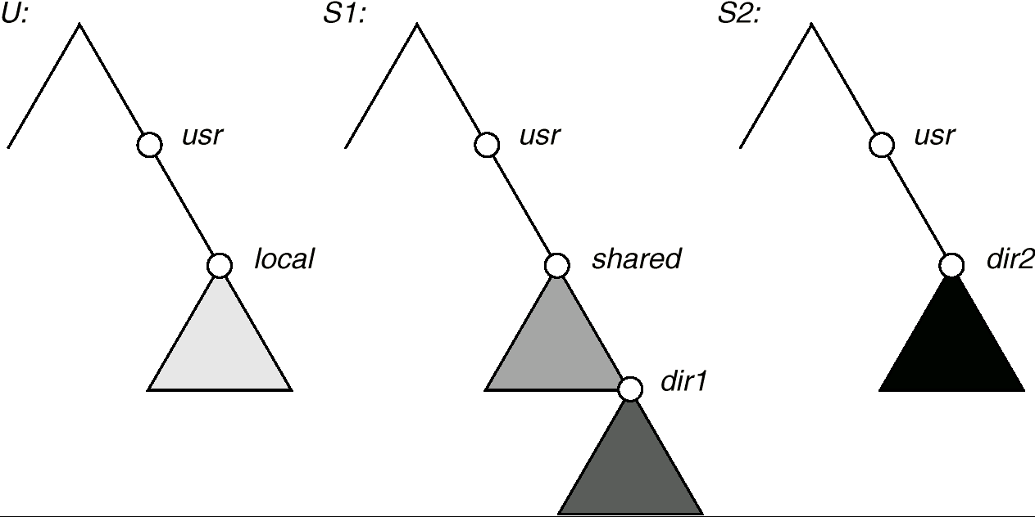
NFS Mounting: Three Independent File Systems

Slide 13
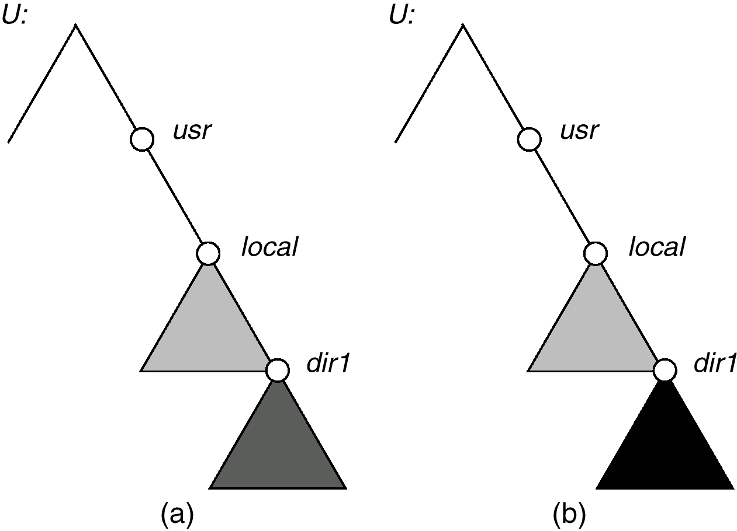
Mounting in NFS
From S1:
From S1:
From S2:
Mounts
Cascading mounts

Slide 14
NFS Mount Protocol
Establishes logical connection between server and client.
Mount operation: name of remote directory & name of server
Mount request → RPC sent to mount server on server machine.
Export list – exportable local file systems & authorized machines.

Slide 15
NFS Mount Protocol
server returns a file handle—a key for further accesses.
File handle – a file-system identifier, and an inode number to identify the mounted directory
The mount operation changes only the user’s view and does not affect the server side.

Slide 16
NFS Advantages
Transparency – clients unaware of local vs remote
Standard operations - open(), close(), fread(), etc.
NFS disadvantages
Files in an NFS volume reside on a single machine
No reliability guarantees if that machine goes down
All clients must go to this machine to retrieve their data

Slide 17
Hadoop Distributed File System
HDFS Advantages:
designed to store terabytes or petabytes
data spread across a large number of machines
supports much larger file sizes than NFS
stores data reliably (replication)

Slide 18
Hadoop Distributed File System
HDFS Advantages:
provides fast, scalable access
serve more clients by adding more machines
integrates with MapReduce →local computation

Slide 19
Hadoop Distributed File System
HDFS Disadvantages
Not as general-purpose as NFS
Design restricts use to a particular class of applications
HDFS optimized for streaming read performance →not good at random access

Slide 20
Hadoop Distributed File System
HDFS Disadvantages
Write once read many model
Updating a files after it has been closed is not supported (can’t append data)
System does not provide a mechanism for local caching of data

Slide 21
Hadoop Distributed File System
HDFS – block-structured file system
File broken into blocks distributed among DataNodes
DataNodes – machines used to store data blocks

Slide 22
Hadoop Distributed File System
Target machines chosen randomly on a block-by-block basis
Supports file sizes far larger than a single-machine DFS
Each block replicated across a number of machines (3, by default)

Slide 23
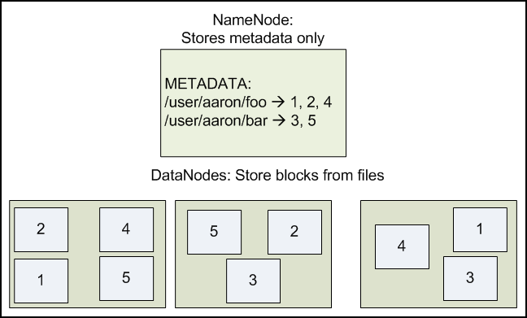
Hadoop Distributed File System

Slide 24
Hadoop Distributed File System
Expects large file size
Small number of large files
Hundreds of MB to GB each
Expects sequential access
Default block size in HDFS is 64MB
Result:
Reduces amount of metadata storage per file
Supports fast streaming of data (large amounts of contiguous data)

Slide 25
Hadoop Distributed File System
HDFS expects to read a block start-to-finish
Useful for MapReduce
Not good for random access
Not a good general purpose file system

Slide 26
Hadoop Distributed File System
HDFS files are NOT part of the ordinary file system
HDFS files are in separate name space
Not possible to interact with files using ls, cp, mv, etc.
Don’t worry: HDFS provides similar utilities

Slide 27
Hadoop Distributed File System
Meta data handled by NameNode
Deal with synchronization by only allowing one machine to handle it
Store meta data for entire file system
Not much data: file names, permissions, & locations of each block of each file

Slide 28
Hadoop Distributed File System

Slide 29
Hadoop Distributed File System
What happens if the NameNode fails?
Bigger problem than failed DataNode
Better be using RAID ;-)
Cluster is kaput until NameNode restored
Not exactly relevant but:
DataNodes are more likely to fail.
Why?

Slide 30
Working with HDFS
Most commands use hadoop
General format:
user@machine:hadoop$ hadoop moduleName -cmd args...
Where moduleName specifies HDFS functionality
Where cmd specifies which command

Slide 31
Preliminary steps in the VM
First: log in to sandbox in vm
URL: vm-hadoop-XX.cse.sc.edu:4200
Where: XX is the vm number assigned to you
Account: maria_dev
Password: qwertyCSCE587
First thing change your password!
Ex: passwd
You will be prompted for your current password
Next you will be prompted for a new password
BE SURE TO KEEP TRACK OF THIS PASSWORD!

Slide 32
Working with HDFS
Listing files:
[maria_dev@sandbox-hdp ~]$ hadoop fs -ls
Note: nothing is listed!!! -ls command returns zilch
Why? The maria_dev top-level directory is empty
With NO arguments, -ls refers to “home directory” in HDFS
/user/maria_dev

Slide 33
Working with HDFS
Try specifying a directory
[maria_dev@sandbox-hdp ~]$ hadoop fs -ls /
Found 11 items
drwxrwxrwx - yarn hadoop 0 2018-06-18 15:18 /app-logs
drwxr-xr-x - hdfs hdfs 0 2018-06-18 16:13 /apps
drwxr-xr-x - yarn hadoop 0 2018-06-18 14:52 /ats
drwxr-xr-x - hdfs hdfs 0 2018-06-18 14:52 /hdp
drwx------ - livy hdfs 0 2018-06-18 15:11 /livy2-recovery
drwxr-xr-x - mapred hdfs 0 2018-06-18 14:52 /mapred
drwxrwxrwx - mapred hadoop 0 2018-06-18 14:52 /mr-history
drwxr-xr-x - hdfs hdfs 0 2018-06-18 15:59 /ranger
drwxrwxrwx - spark hadoop 0 2020-03-29 17:55 /spark2-history
drwxrwxrwx - hdfs hdfs 0 2018-06-18 16:06 /tmp
drwxr-xr-x - hdfs hdfs 0 2018-06-18 16:08 /user

Slide 34
Loading data
First create a directory
[maria_dev@sandbox-hdp ~]$ hadoop fs -mkdir Example
Note: This is equivalent to hadoop fs -mkdir /user/maria_dev/Example
Next wget a file so we have something to upload
[maria_dev@sandbox-hdp ~]$ wget https://cse.sc.edu/~rose/587/CSV/iris.csv
Verify that that iris.csv is in the current working linix directory
[maria_dev@sandbox-hdp ~]$ ls
iris.csv

Slide 35
Loading data
Next upload a file (uploads to /user/maria_dev)
[maria_dev@sandbox-hdp ~]$ hadoop fs -put iris.csv Example/
Verify the file is in HDFS
[maria_dev@sandbox-hdp ~]$ hadoop fs -ls Example
Found 1 items
-rw-r--r-- 1 maria_dev hdfs 4617 2020-03-29 18:19 Example/iris.csv

Slide 36
Loading data
You can also “put” multiple files
Consider a directory: myfiles
Contents: Bayes.csv FBS2016.csv Subdirectory: subdir/
Content: iris.csv
Let’s “put” all of these file in the HDFS
[maria_dev@sandbox-hdp ~]$ hadoop fs -put myfiles /user/maria_dev
[maria_dev@sandbox-hdp ~]$ hadoop fs -ls /user/maria_dev
Found 1 items
drwxr-xr-x - maria_dev hdfs 0 2017-11-01 20:58 /user/maria_dev/myfiles
[maria_dev@sandbox-hdp ~]$ hadoop fs -ls /user/maria/myfiles
Found 3 items
-rw-r--r-- 1 maria_dev hdfs 247 2017-11-01 20:58 /user/maria_dev/myfiles/Bayes.csv
-rw-r--r-- 1 maria_dev hdfs 62369 2017-11-01 20:58 /user/maria_dev/myfiles/FBS2016.csv
drwxr-xr-x - maria_dev hdfs 0 2017-11-01 20:58 /user/maria_dev/myfiles/subdir

Slide 37
Getting data from HDFS
We can use cat to display a file to stdout
[maria_dev@sandbox-hdp ~]$ hadoop fs -cat Example/iris.csv
We can “get” files from the Hadoop File System
[maria_dev@sandbox-hdp ~]$ hadoop fs -get Example/iris.csv irisCsvFile.csv
[maria_dev@sandbox-hdp ~]$ ls
iris.csv irisCsvFile.csv

Slide 38
Other commands
Hadoop will list all commands that can be run with the FS Shell with the command:
[maria_dev@sandbox-hdp ~]$ hadoop fs

